Slide 1


Slide 2

Choosing the Right Error Measurement
. You are asked to build a classifier for leukemia
. Training data: 1% patients with leukemia, 99% healthy
. Measure accuracy: total % of predictions that are correct
32

Slide 3
Choosing the Right Error Measurement
. You are asked to build a classifier for leukemia
. Training data: 1% patients with leukemia, 99% healthy
. Measure accuracy: total % of predictions that are correct
. Build a simple model that always predicts “healthy”
. Accuracy will be 99%…
33

Slide 4
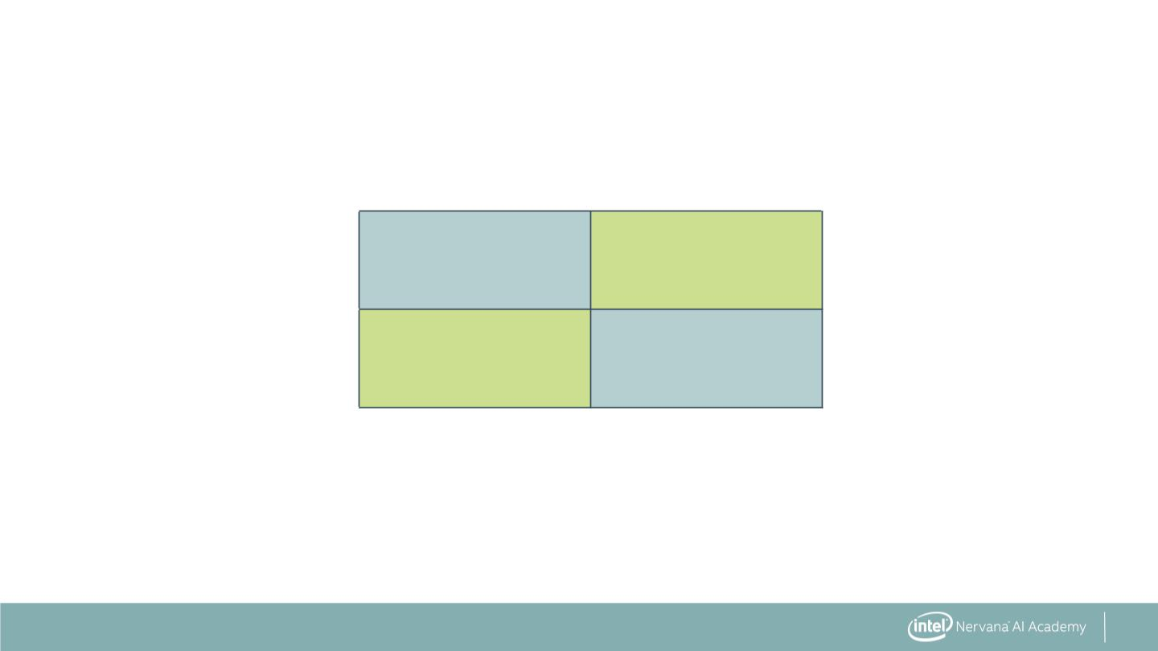
Confusion Matrix
Predicted
Positive
Predicted
Negative
Actual
Positive
True Positive
(TP)
False Negative
(FN)
Actual
Negative
False Positive
(FP)
True Negative
(TN)
34

Slide 5
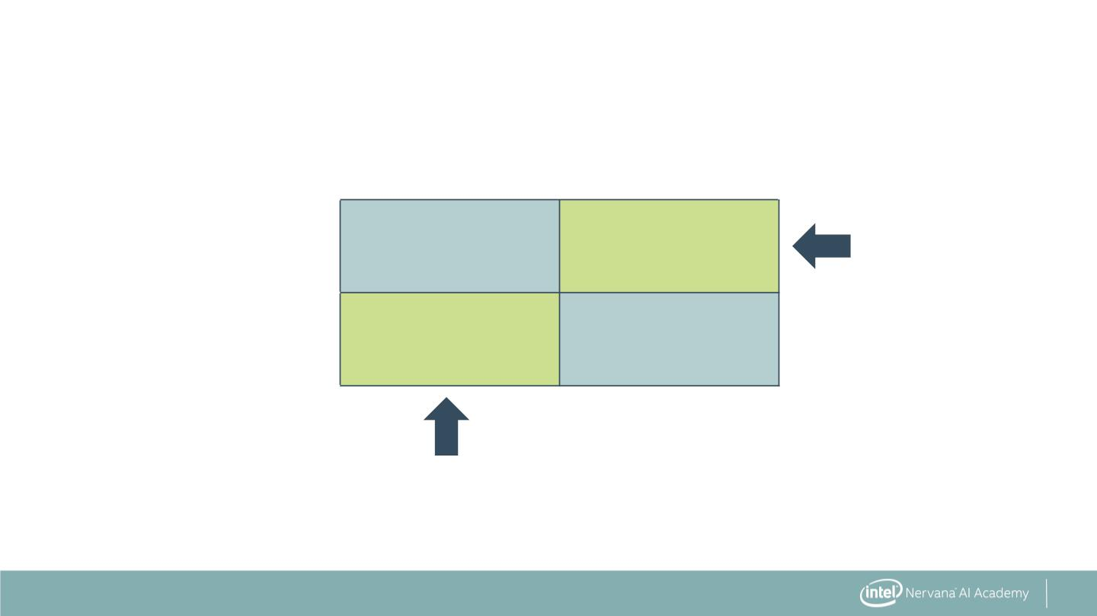
Confusion Matrix
Predicted
Positive
Predicted
Negative
Actual
Positive
True Positive
(TP)
False Negative
(FN)
Type II Error
Actual
Negative
False Positive
(FP)
True Negative
(TN)
Type I Error
35

Slide 6
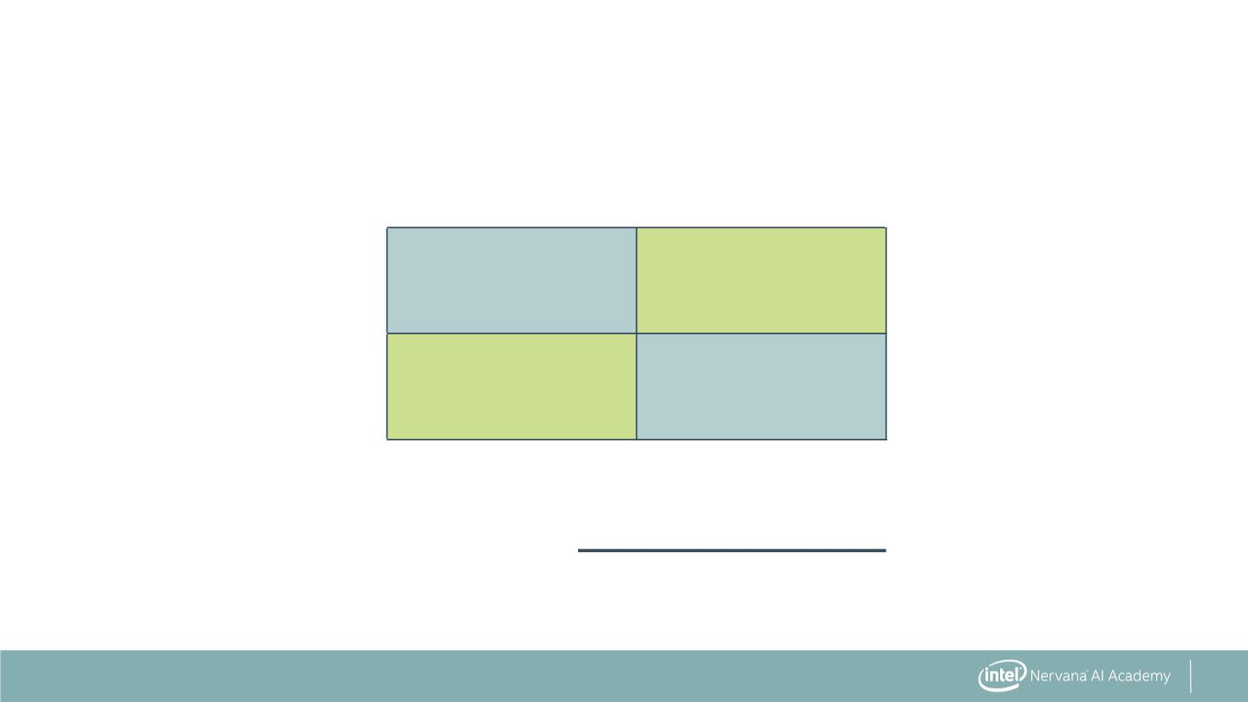
Accuracy: Predicting Correctly
Predicted
Positive
Predicted
Negative
Actual
Positive
True Positive
(TP)
False Negative
(FN)
Actual
Negative
False Positive
(FP)
True Negative
(TN)
TP + TN
Accuracy =
TP + FN + FP + TN
36

Slide 7
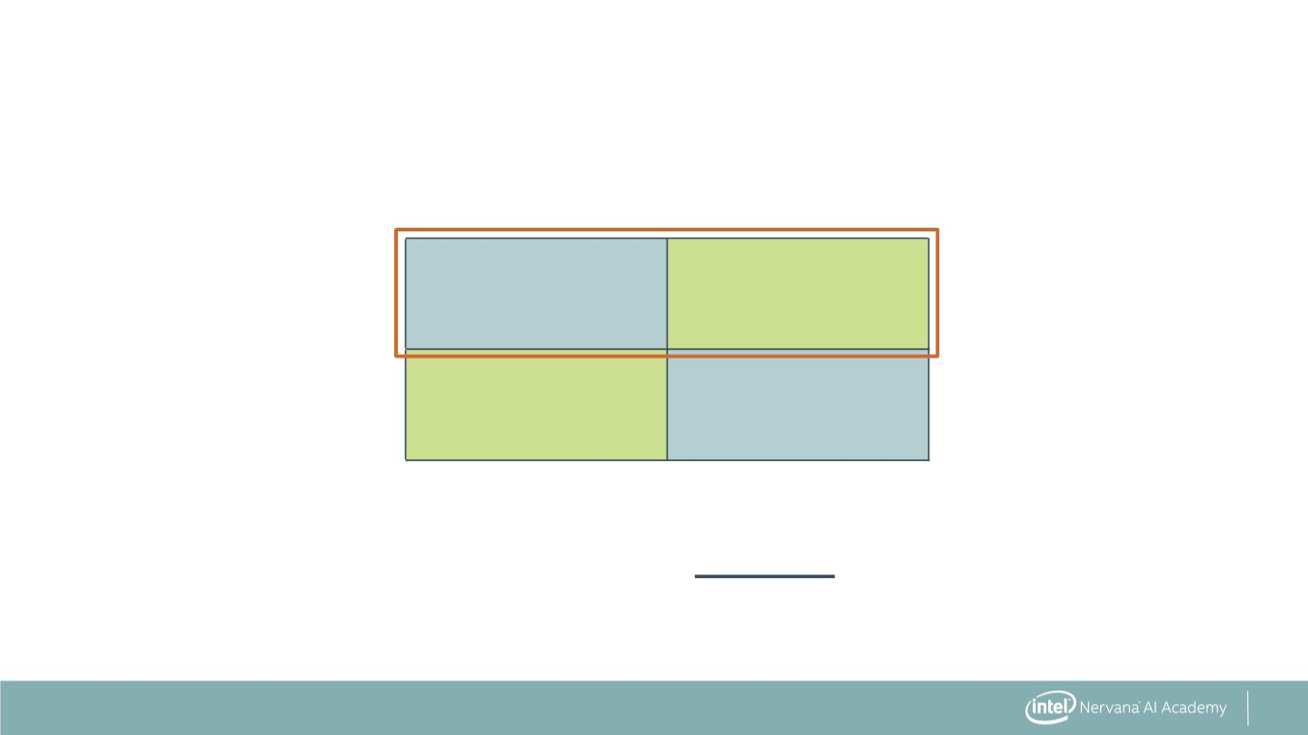
Recall: Identifying All Positive Instances
Predicted
Positive
Predicted
Negative
Actual
Positive
True Positive
(TP)
False Negative
(FN)
Actual
Negative
False Positive
(FP)
True Negative
(TN)
Recall or
Sensitivity
TP
=
TP + FN
37

Slide 8
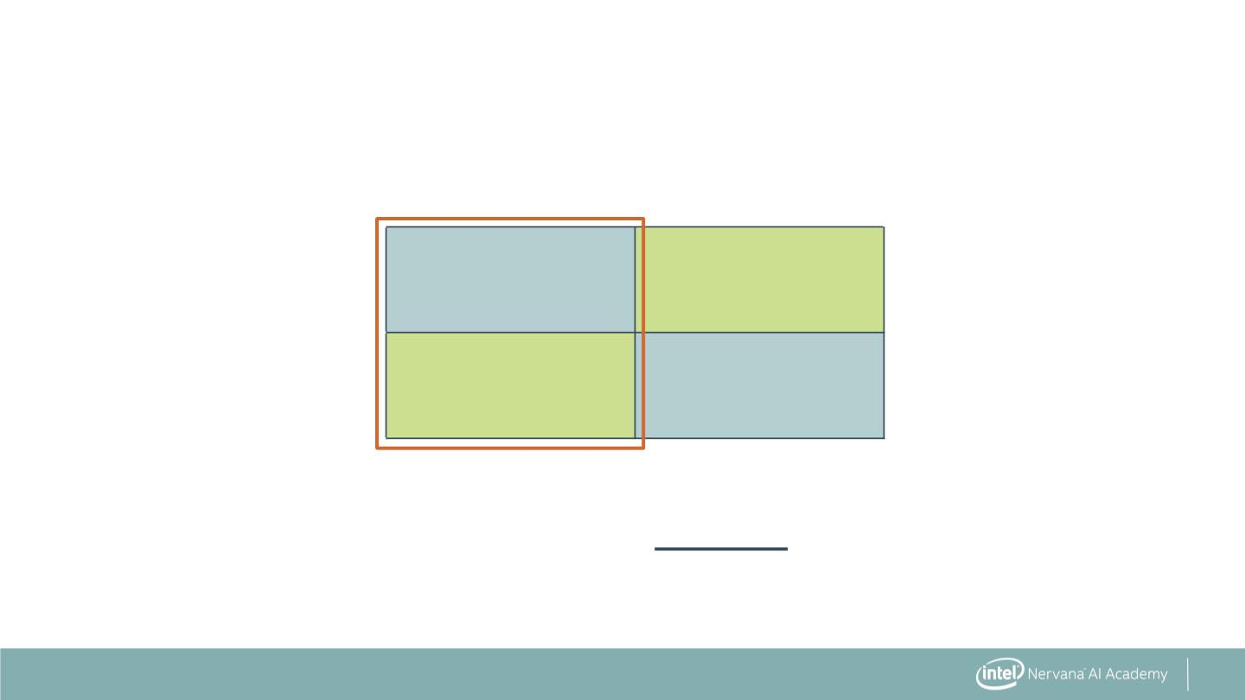
Precision: Identifying Only Positive Instances
Predicted
Positive
Predicted
Negative
Actual
Positive
True Positive
(TP)
False Negative
(FN)
Actual
Negative
False Positive
(FP)
True Negative
(TN)
TP
Precision =
TP + FP
38

Slide 9
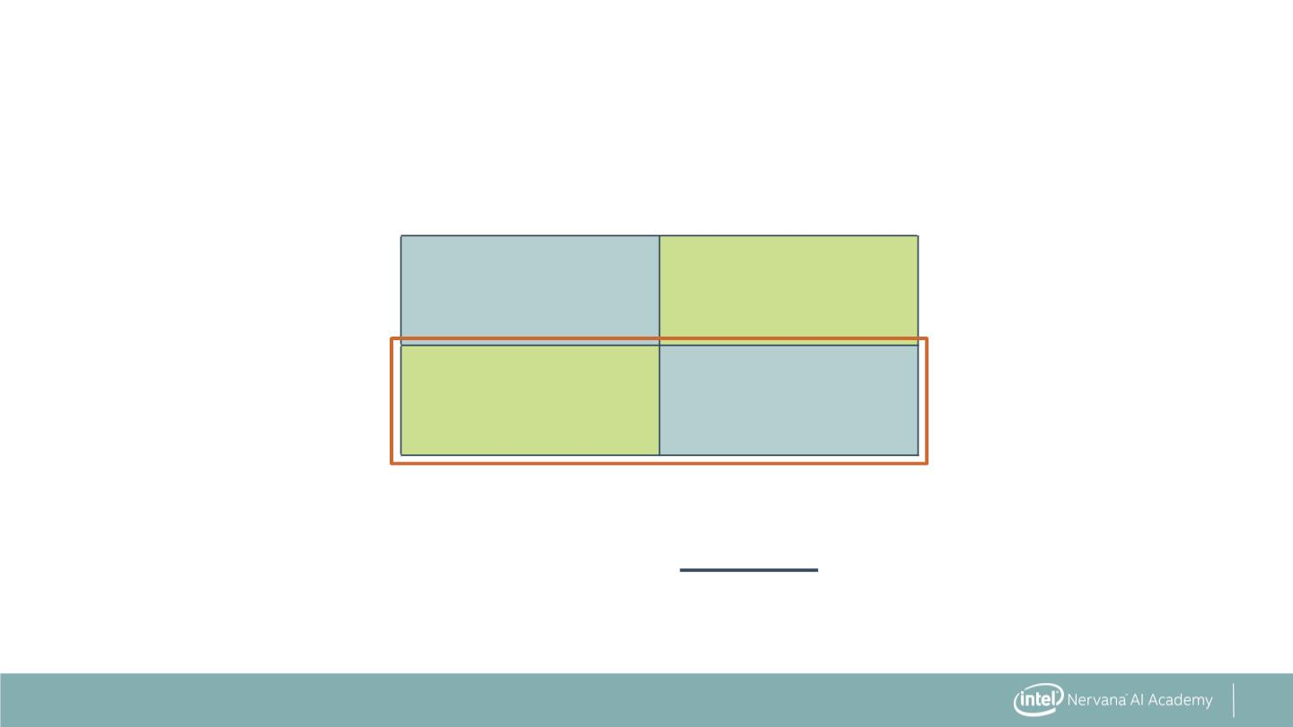
Specificity: Avoiding False Alarms
Predicted
Positive
Predicted
Negative
Actual
Positive
True Positive
(TP)
False Negative
(FN)
Actual
Negative
False Positive
(FP)
True Negative
(TN)
TN
Specificity =
FP + TN
39

Slide 10
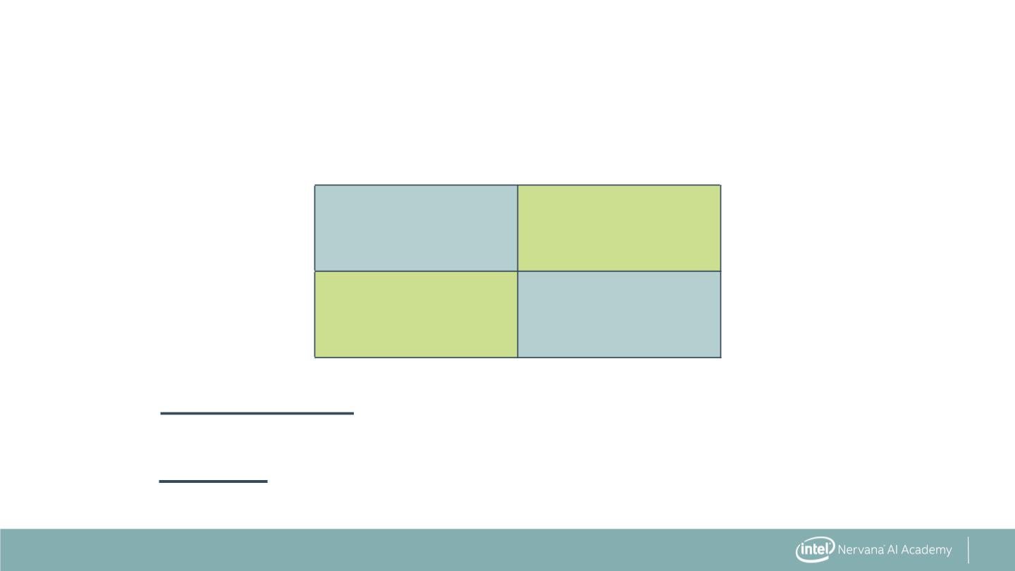
Error Measurements
Predicted
Positive
Predicted
Negative
Actual
Positive
True Positive
(TP)
False Negative
(FN)
Actual
Negative
False Positive
(FP)
True Negative
(TN)
TP + TN
Accuracy =
TP + FN + FP + TN
TP
Precision =
TP + FP
40

Slide 11
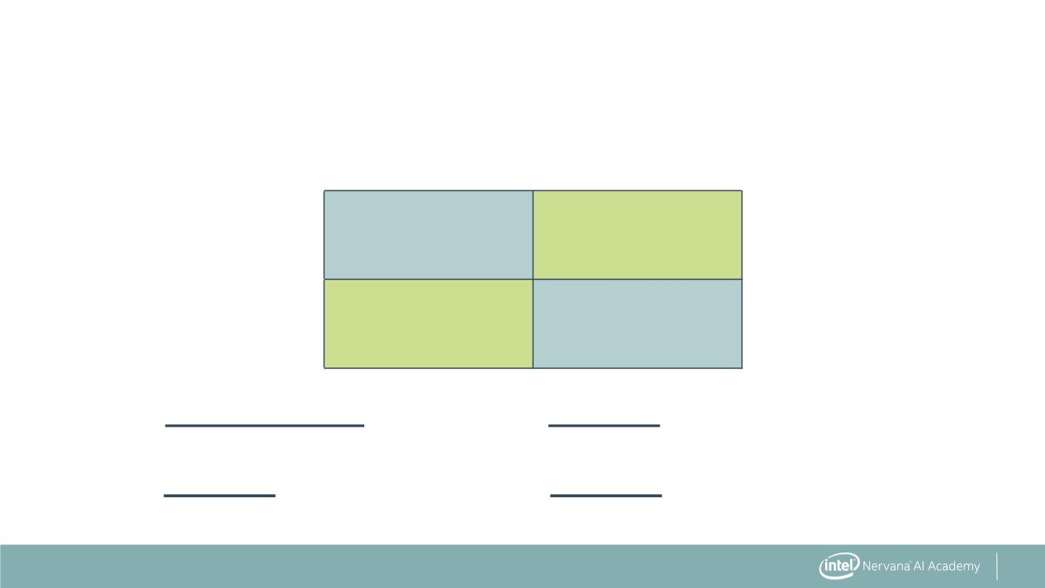
Error Measurements
Predicted
Positive
Predicted
Negative
Actual
Positive
True Positive
(TP)
False Negative
(FN)
Actual
Negative
False Positive
(FP)
True Negative
(TN)
TP + TN
Accuracy =
Recall or
TP
=
TP + FN + FP + TN
Sensitivity
TP + FN
TN
TP
Precision =
Specificity =
TP + FP
FP + TN
41

Slide 12
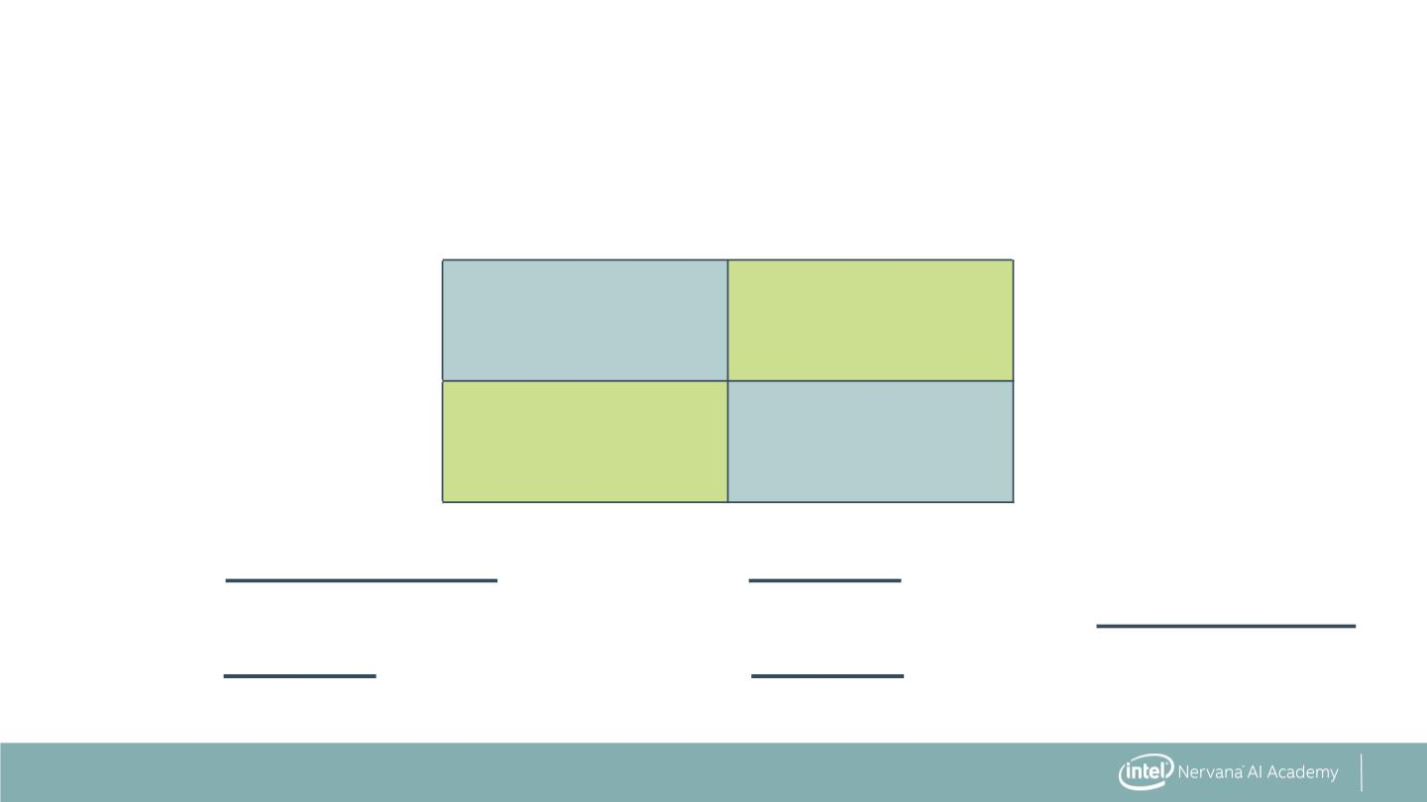
Error Measurements
Predicted
Positive
Predicted
Negative
Actual
Positive
True Positive
(TP)
False Negative
(FN)
Actual
Negative
False Positive
(FP)
True Negative
(TN)
TP + TN
Accuracy =
Recall or
TP
=
TP + FN + FP + TN
Sensitivity
TP + FN
TN
Precision * Recall
Precision + Recall
F1 = 2
TP
Precision =
Specificity =
TP + FP
FP + TN
42

Slide 13
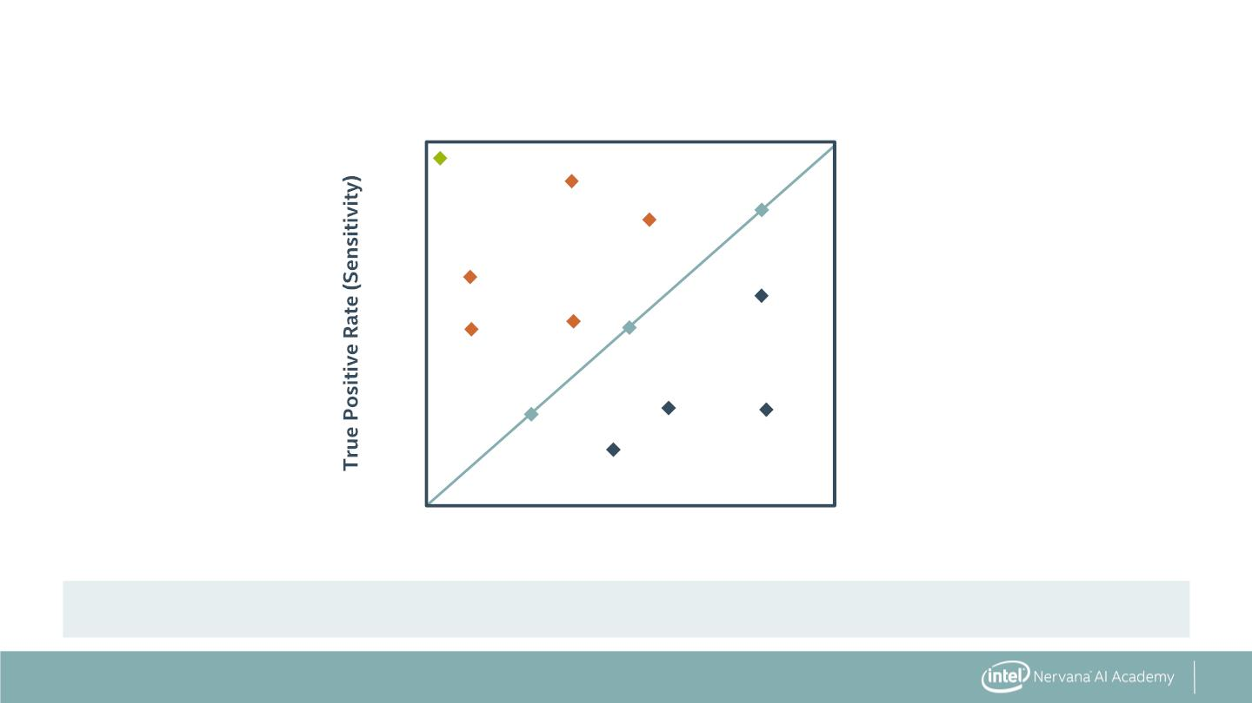
Receiver Operating Characteristic (ROC)
1.0
Perfect
Model
0.8
Better
0.6
Random
Guess
0.4
0.2
Worse
0.8
0.2
0.4
0.6
1.0
False Positive Rate (1–Specificity)
Evaluation of model at all possible thresholds
43

Slide 14
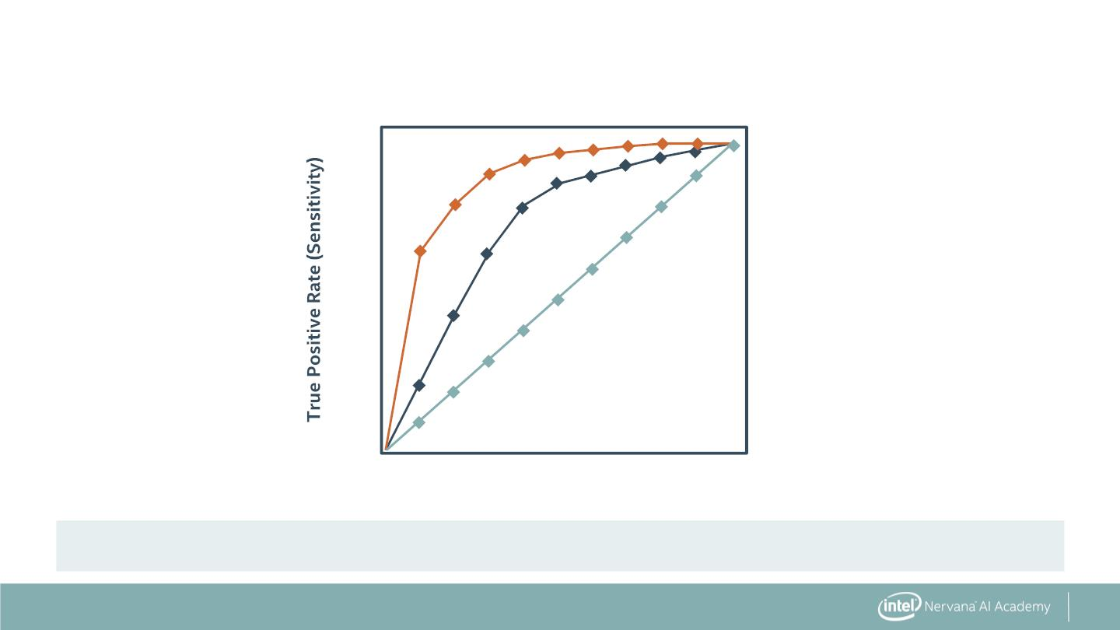
Area Under Curve (AUC)
1.0
0.8
0.6
0.4
0.2
AUC 0.9
AUC 0.75
AUC 0.5
0.2
0.4
0.6
0.8
1.0
False Positive Rate (1–Specificity)
Measures total area under ROC curve
44

Slide 15
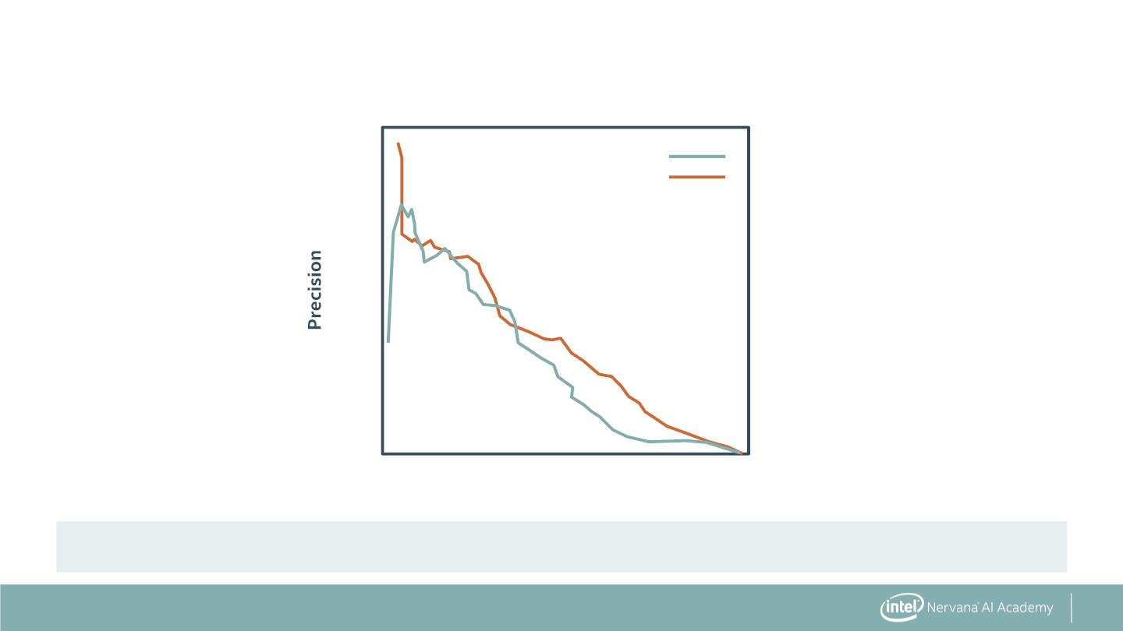
Precision Recall Curve (PR Curve)
1.0
0.8
0.6
0.4
0.2
Model 1
Model 2
0.2
0.4
Recall
0.6
0.8
1.0
Measures trade-off between precision and recall
45

Slide 16
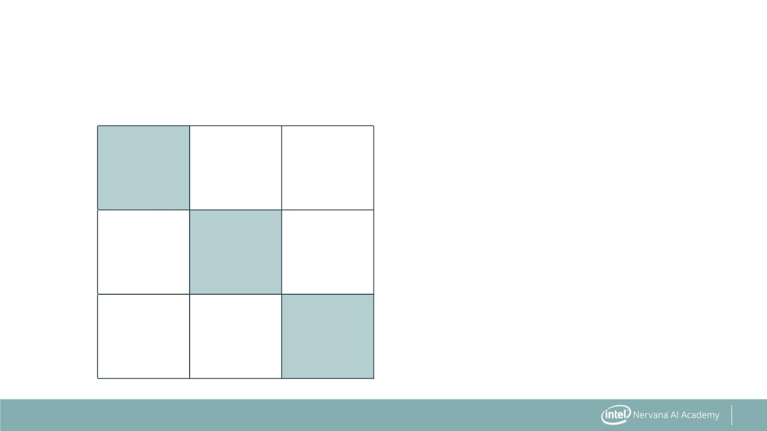
Multiple Class Error Metrics
Predicted
Class 1
Predicted
Class 2
Predicted
Class 3
Actual
Class 1
TP1
Actual
Class 2
TP2
Actual
Class 3
TP3
46

Slide 17

Multiple Class Error Metrics
Predicted
Class 1
Predicted
Class 2
Predicted
Class 3
TP1 + TP2 + TP3
Total
Actual
Class 1
TP1
Accuracy =
Actual
Class 2
TP2
Actual
Class 3
TP3
47

Slide 18
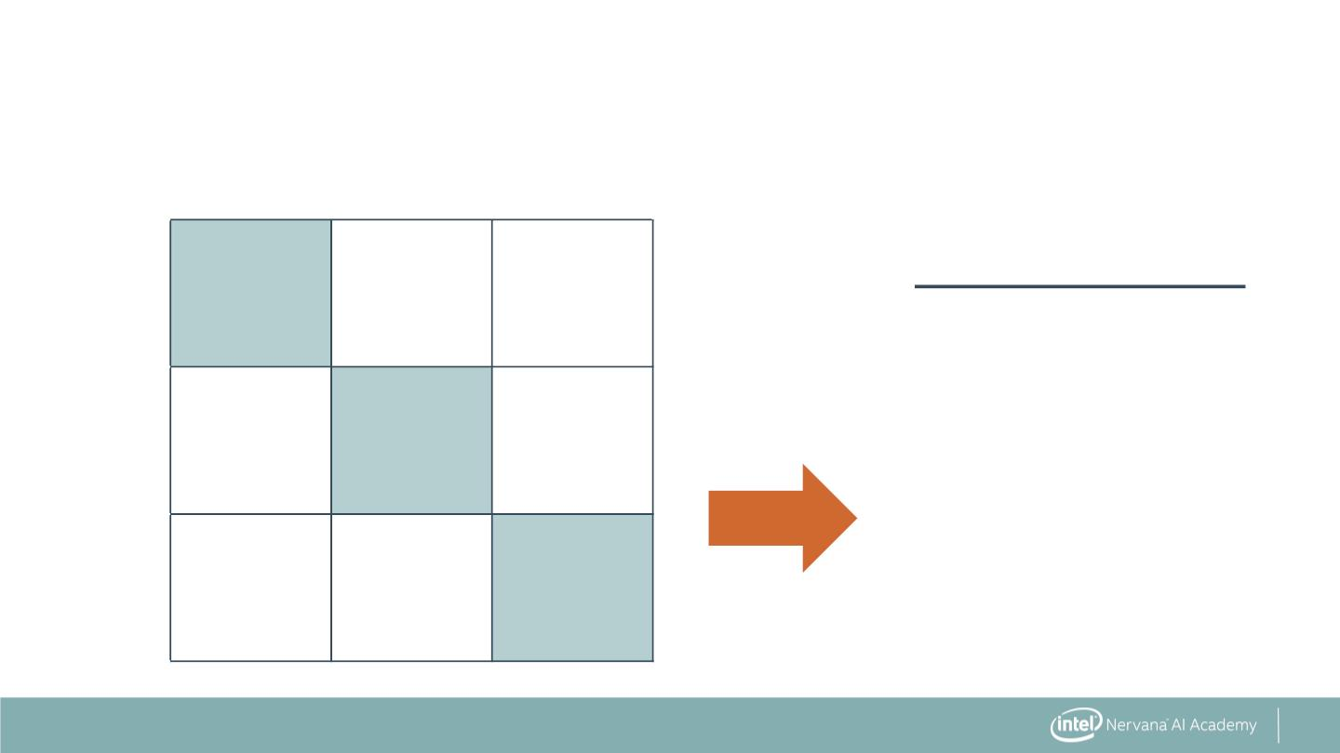
Multiple Class Error Metrics
Predicted
Class 1
Predicted
Class 2
Predicted
Class 3
TP1 + TP2 + TP3
Total
Actual
Class 1
TP1
Accuracy =
Actual
Most multi-class error
metrics are similar
to binary versions—
just expand elements
as a sum
TP2
Class 2
Actual
Class 3
TP3
48

Slide 19
Classification Error Metrics: The Syntax
Import the desired error function
from sklearn.metrics import accuracy_score
49

Slide 20
Classification Error Metrics: The Syntax
Import the desired error function
from sklearn.metrics import accuracy_score
Calculate the error on the test and predicted data sets
accuracy_value = accuracy_score(y_test, y_pred)
50

Slide 21
Classification Error Metrics: The Syntax
Import the desired error function
from sklearn.metrics import accuracy_score
Calculate the error on the test and predicted data sets
accuracy_value = accuracy_score(y_test, y_pred)
Lots of other error metrics and diagnostic tools:
from sklearn.metrics import precision_score, recall_score,
f1_score, roc_auc_score,
confusion_matrix, roc_curve,
precision_recall_curve
51

Slide 22


